Slide 1


Course: Guided Research Project Title: Federated Machine Learning Implementation on Image Classification
COMPUTER SCIENCE AND DATA ANALYTICS
Student: Ali Asgarov
Instructors & Supervisors: Dr. Stephen Kaisler, Dr. Jamal Hasanov
Date: 08.03.2023

Slide 2



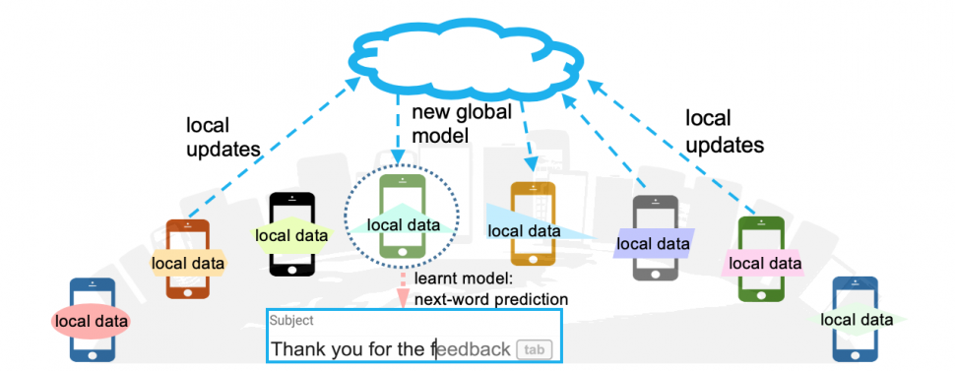




Project Objective
Why today ?
What are the limits of current practice ?
What’s new in our approach ?
Standard machine learning approaches necessarily require storing training data on a single machine or in datacenter.
Why can’t we just centralize the data all the time ?
Sending the data may be too costly
Self-driving cars generates several TBs of data a day
Wireless devices have limited bandwidth/power
Data may be considered too sensitive
Public awareness and regulations on data privacy
Control of data is advantage in business/research
Federated Learning (FL) – Keep data decentralized.
Collaborative ML model training on decentralized data.
Each client’s raw data is stored locally .
Parameter aggregation.
Control over data.
No need to high data transmission bandwidth/power.
Leveraging local data diversity – improving accuracy.
Heilmeier questions noted in green through the whole presentation.

Slide 3
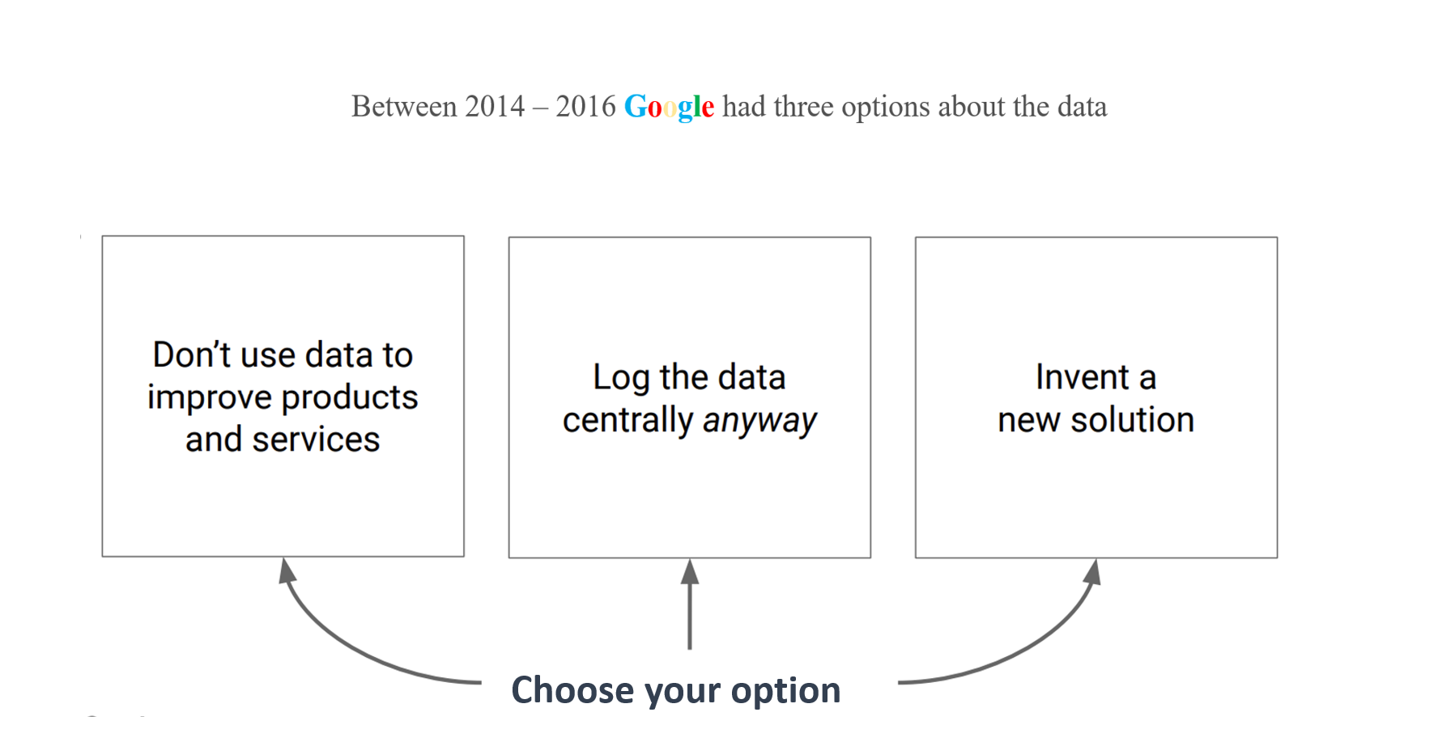
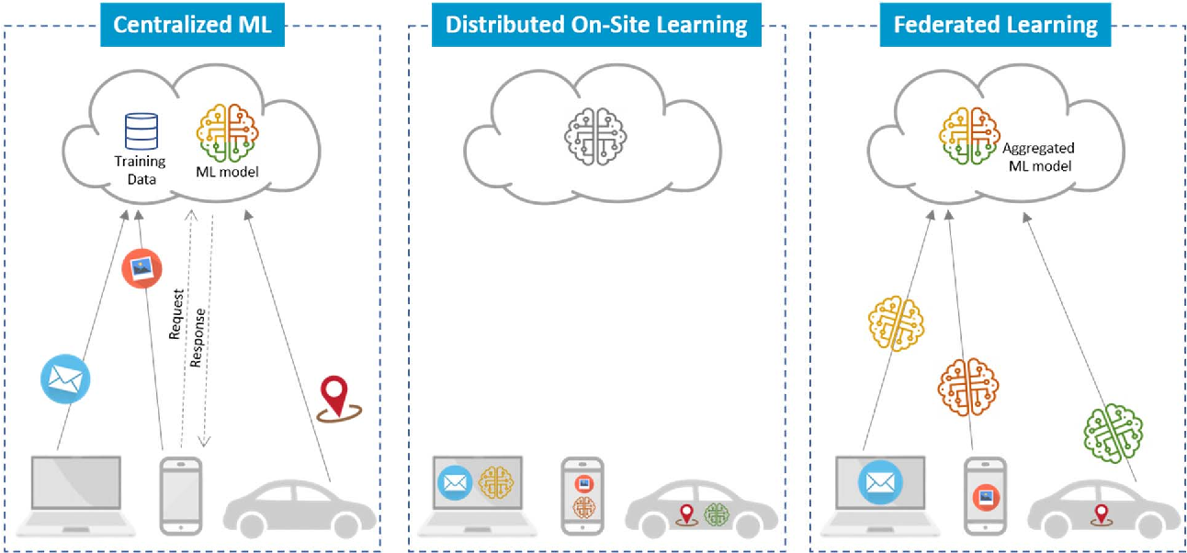

Literature Review
FL is a relatively new type of learning that Google (McMahan) introduced in 2016.
FL is highly multidisciplinary.
The IID is important to ensure optimization is unbiased.
Convergence guaranteed for IID data.
Centralized ML model.
Usage via API.
Shared data across all nodes
Local data across all nodes
Privacy concerns.
Decentralized model aggregation

Slide 4
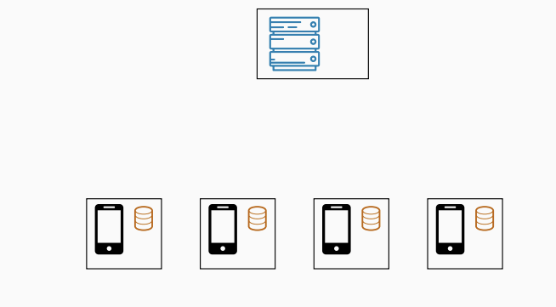
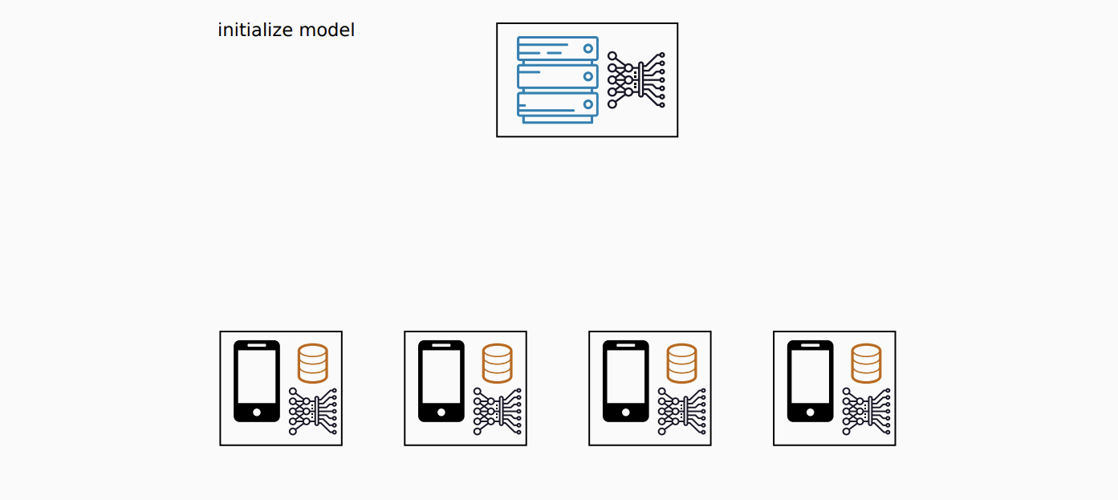
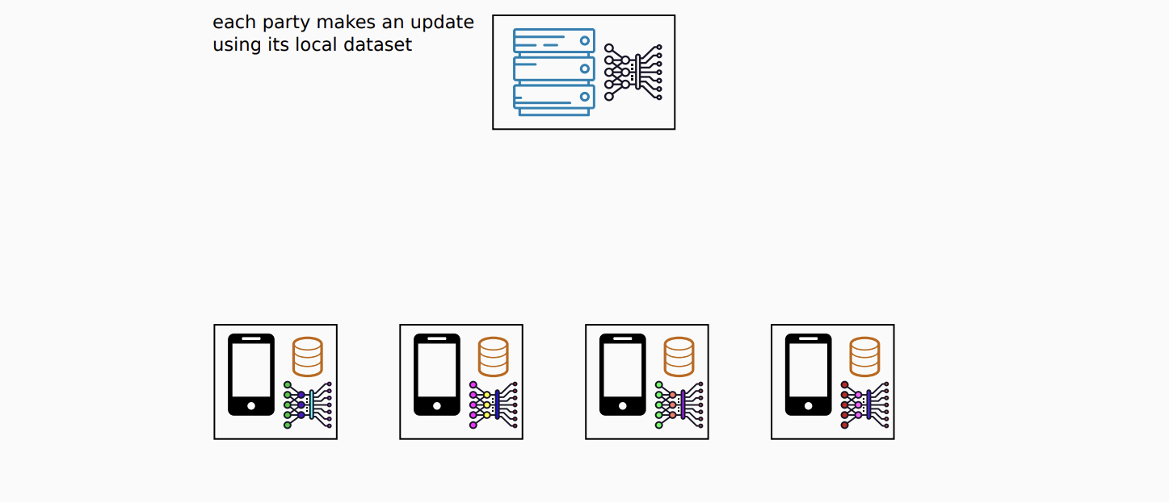
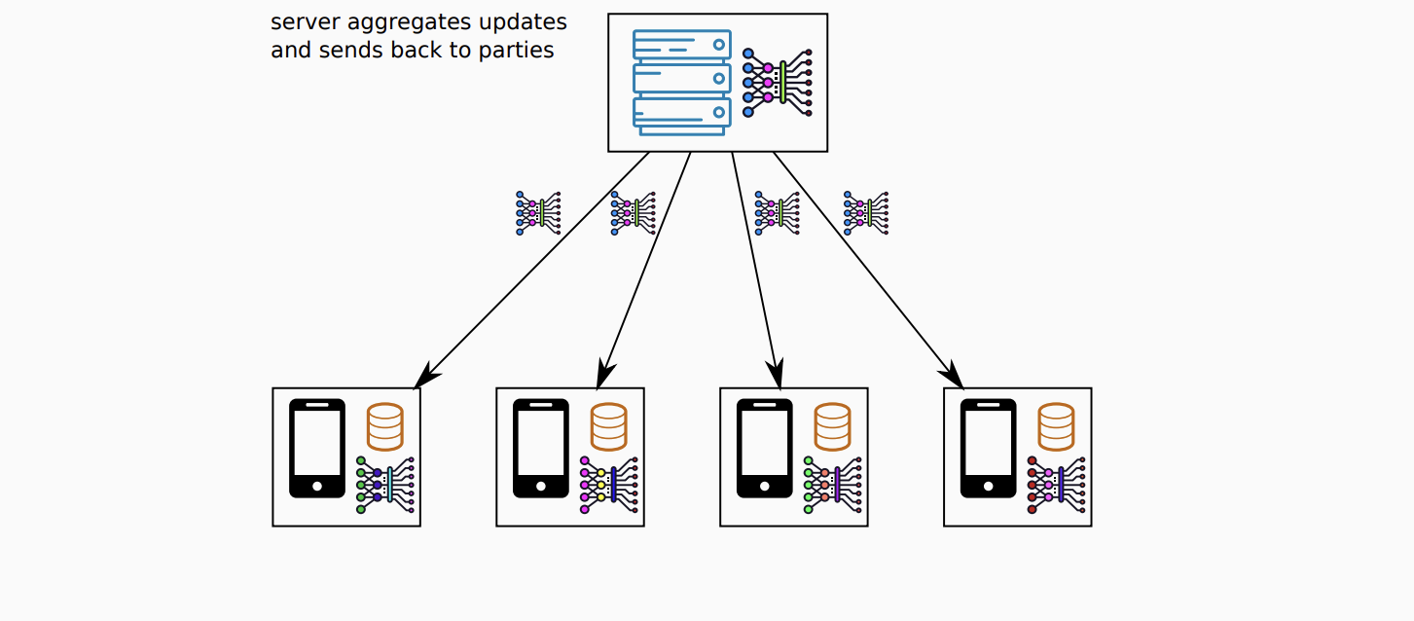
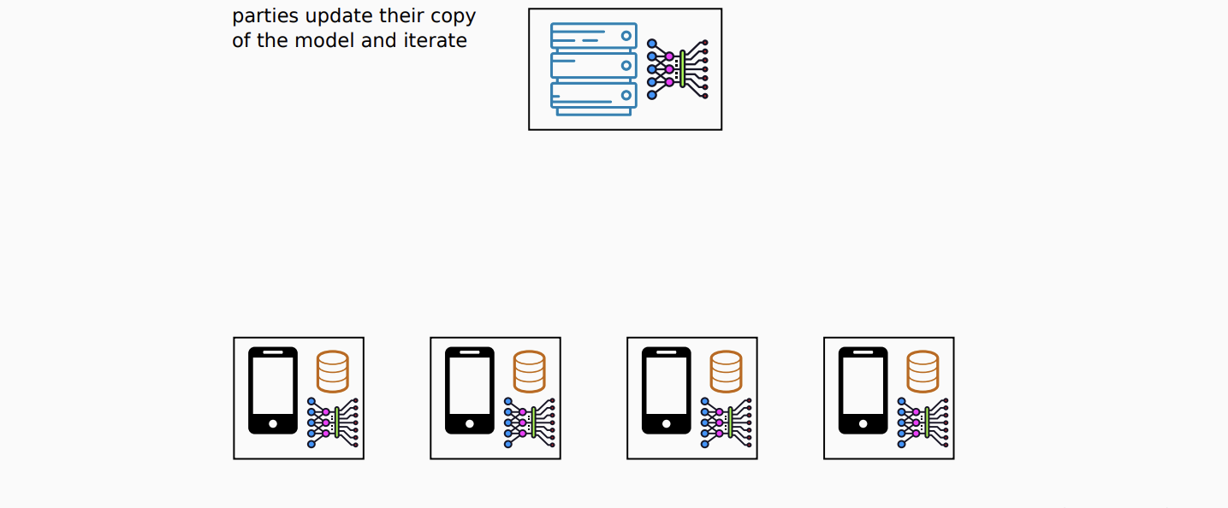
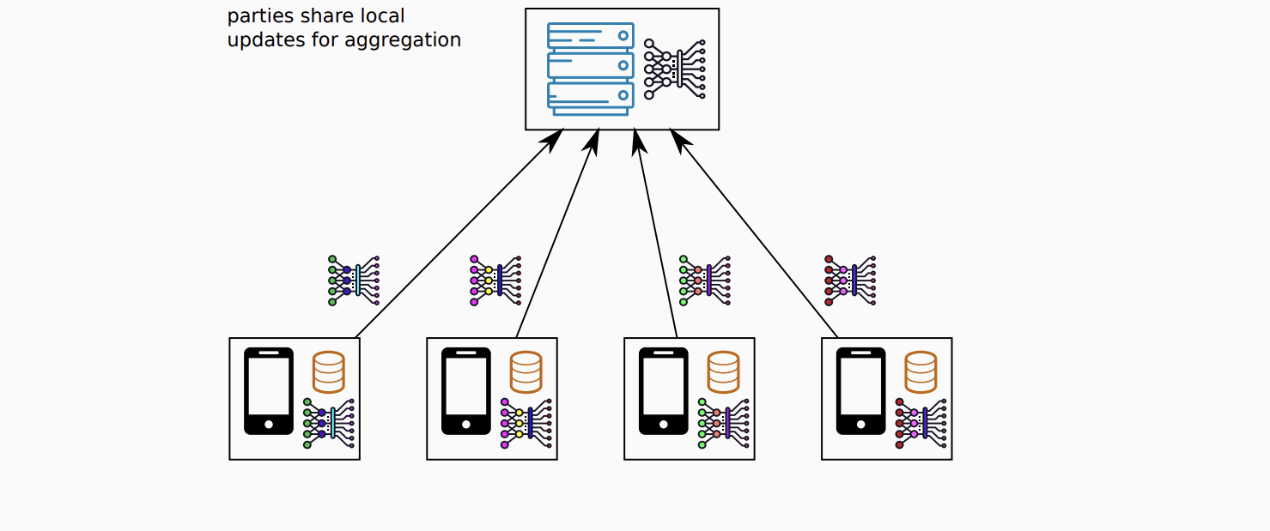
Solution Architecture
Data preparation (IID)
Initialize models
Train local models on the data samples
Averaged weights are sent to the local clients
Local models weights are being averaged
Sharing the model weights to the central model

Slide 5
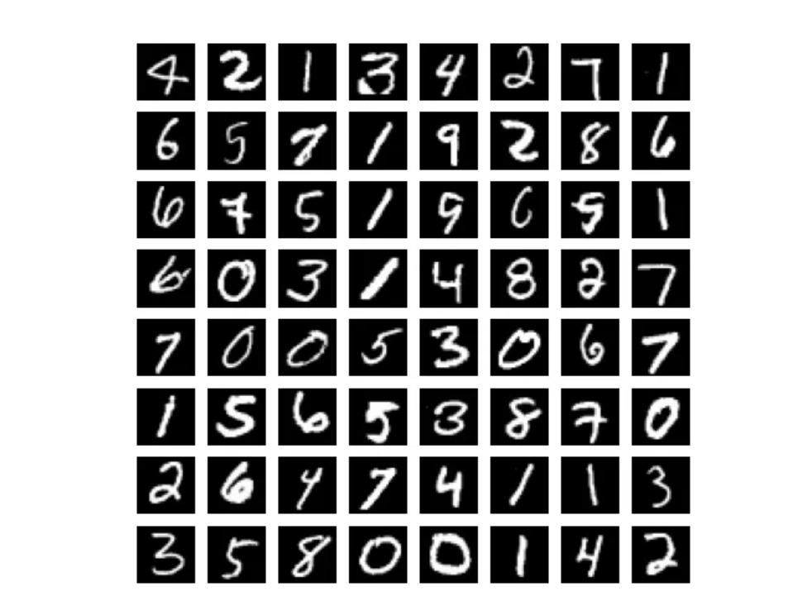
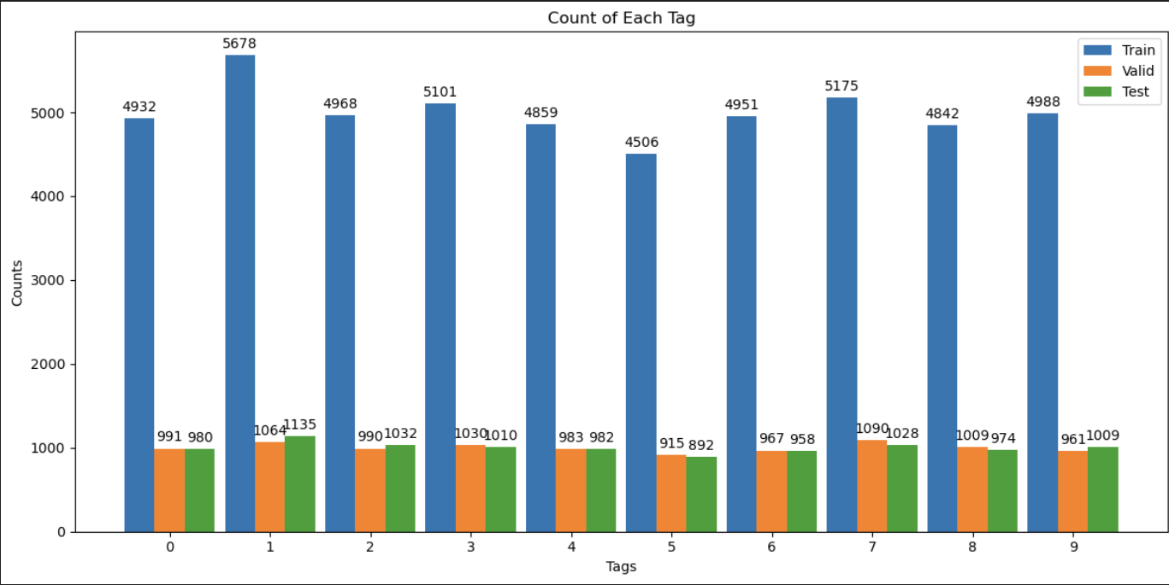



Dataset | Ingestion | Preprocessing
MNIST Dataset - 28 * 28 pixel grayscale images of numbers from 0 to 9.
The MNIST data set does not contain each label equally.
The IID sampling of the training data needed.
To fulfill the IID requirement :
Shuffling data and building dictionary for indexes of labels
Building of client dataset dictionaries with shuffled data
Building of client datasets with previous steps’ dictionaries

Slide 6
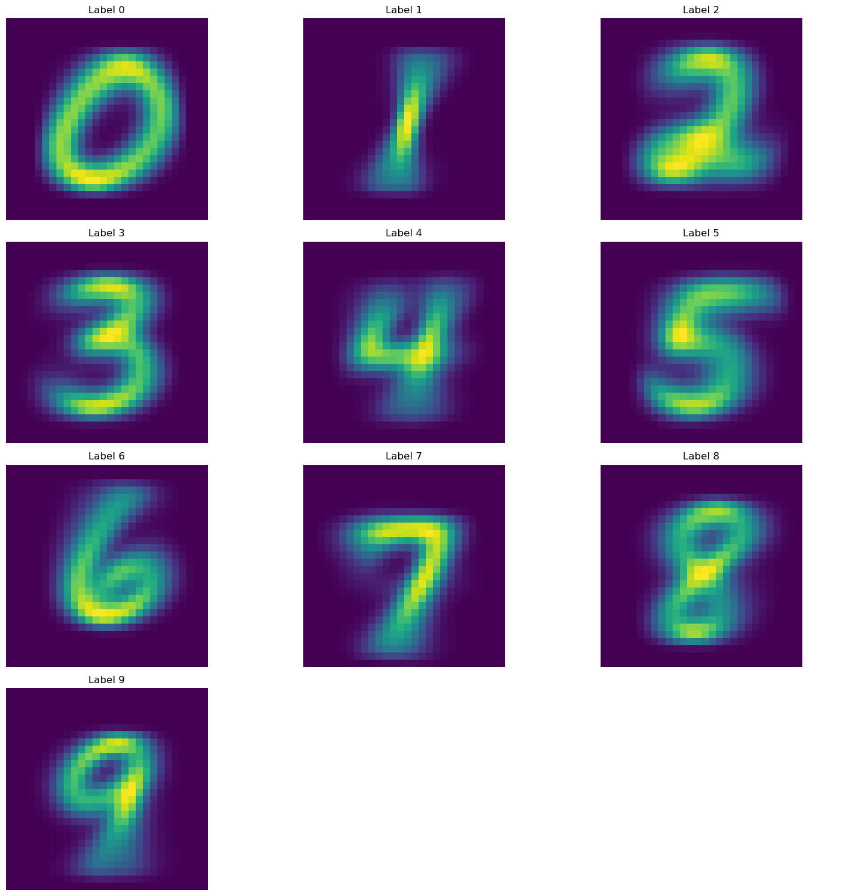
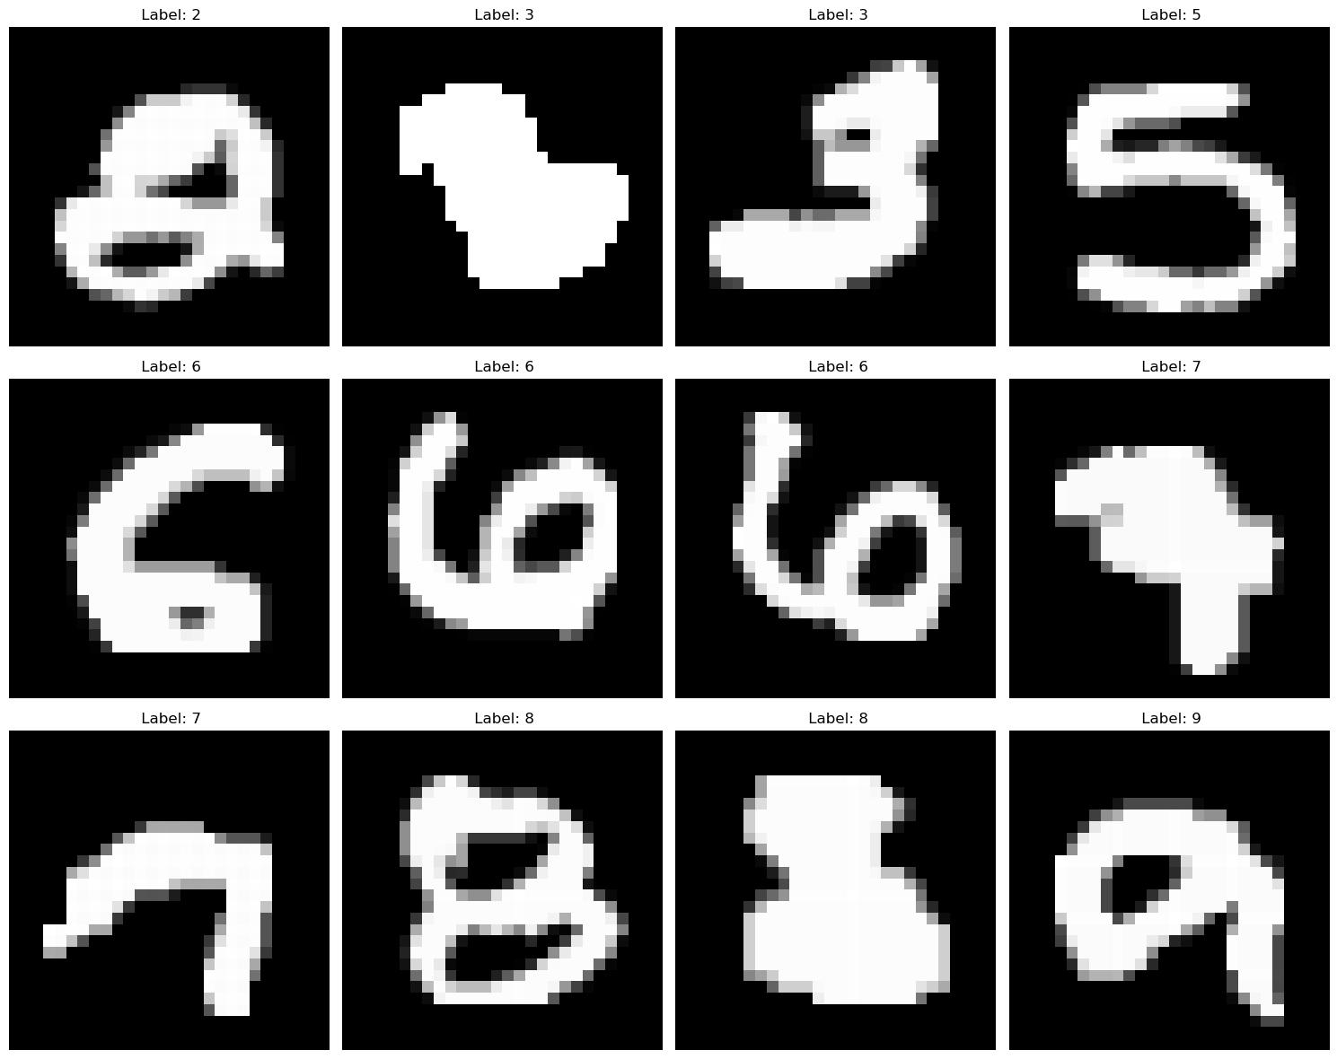
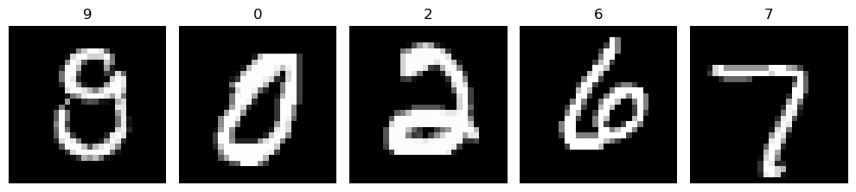
Dataset Cleaning
Heatmap for each label
Outlier detection
Normalization
Feature scaling to ensure all features (pixels) are on a similar scale.
Calculated the mean image (2000 random samples) for building heatmap.
Calculating the Euclidean distance between samples and the mean image.
Normalized the pixel values of the images to a range between 0 and 1 by dividing to 255.
Mean image - array mean values reshaped into a 28x28 matrix.
Defining outlier threshold – (100).
Before normalization
After normalization
Indices of outlier images:
[41453, 24798, 25315, 36193, 29489, 25317, 8488, 59423, 8586, 18598]

Slide 7
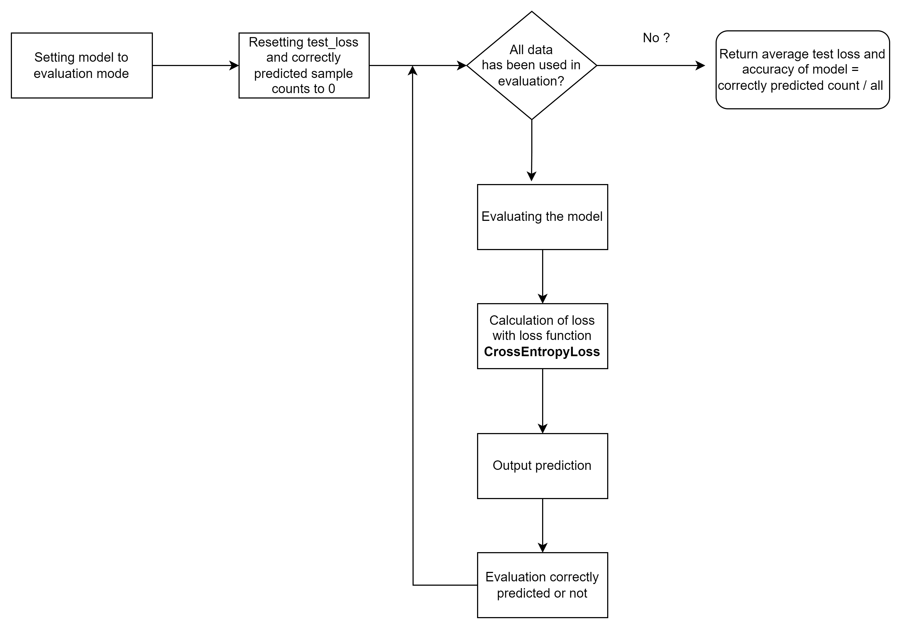
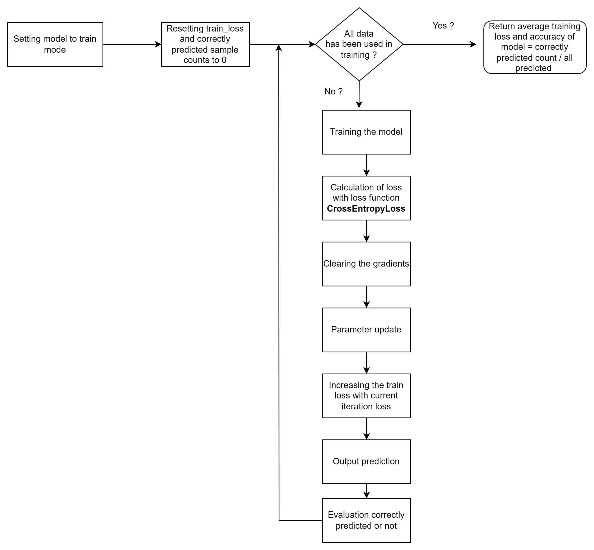
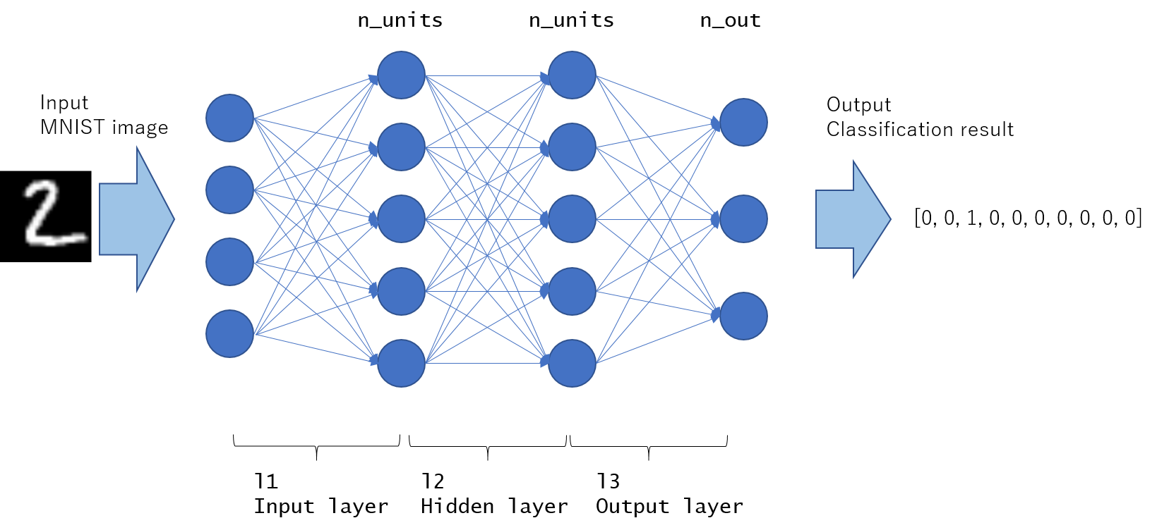
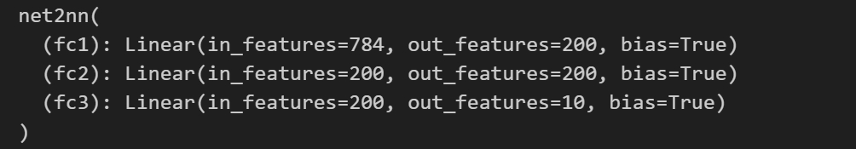
Modelling
Training
A 3-layer model was created for the classification process.
Validation

Slide 8
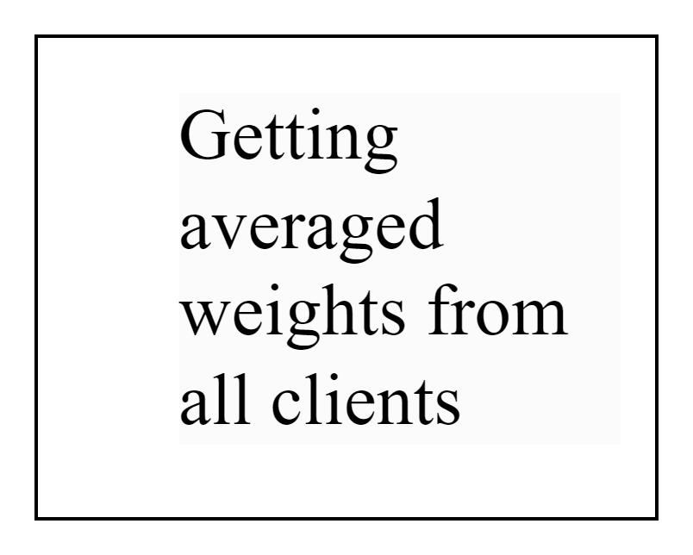
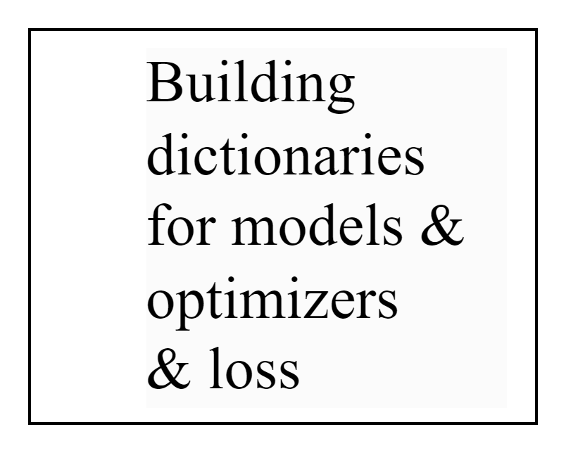
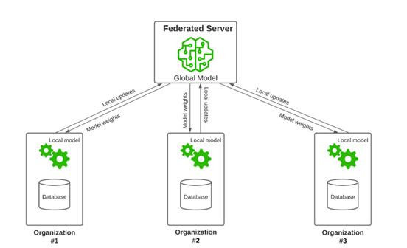
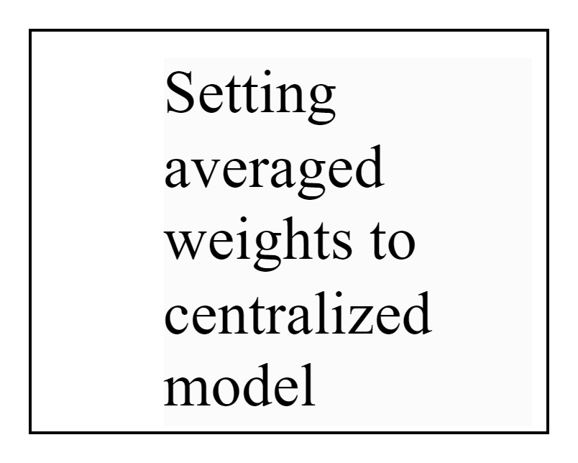
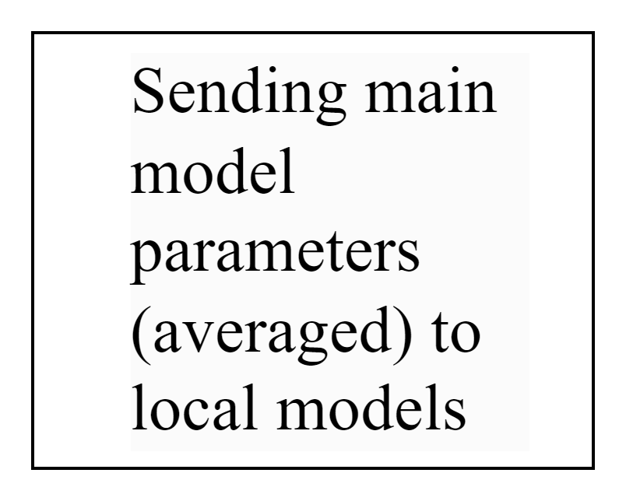
Federated averaging methods
get_averaged_weights
Federated learning functions implemented:
create_model_optimizer_criterion_dict
set_averaged_weights_as_main_model_weights_and_update_main_model
send_main_model_to_nodes_and_update_model_dict

Slide 9
Measurement and Analysis
Dependent variable : Accuracy of the main classification model
Independent variables :
Number of clients
Learning rate
Number of epochs for training
Batch size
Designing experiments: Created a series of experiments where I systematically vary the independent
variables while keeping other factors constant

Slide 10
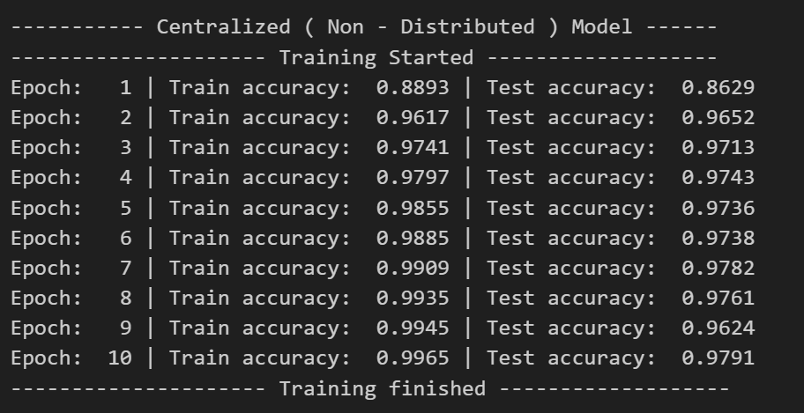
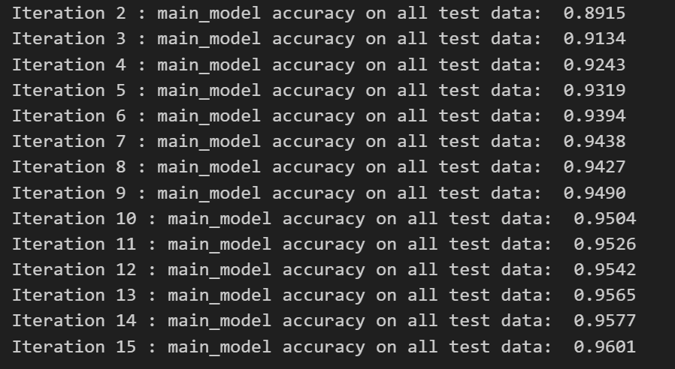
Results
Centralized model with centralized and non-IID data ?
Chosen parameters from the measurement and analysis
number_of_clients is 100
learning_rate is 0.2
numEpoch is 30
batch_size is 64
momentum is 0.2
train_amount is 4000 for each label (build IID data)
test_amount is 1000 for each label (build IID data)
Train (50000) and test (10000) amounts are full train and test data
learning_rate is 0.2
momentum is 0.2
numEpoch is 30
Implementation is done on 16 core CPU, 3.2 GHz base speed
15 iterations have been done for the convergence.

Slide 11
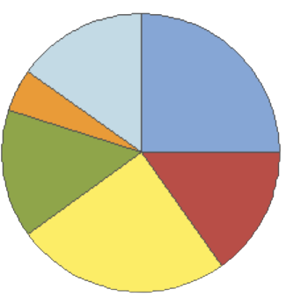


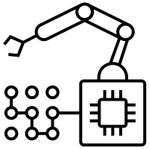







Conclusion and future scope
What have been achieved ?
Centralized model ( not FL) achieved an accuracy of 97.9%.
FedAvg averaging process reaching an impressive 96.01% accuracy without seeing the data.
What were the risks and what are the next steps ?
Handling Heterogeneity
FedAvg is dependent on the IID data
Working on the non-IID data.
Data Privacy
Adaptive Learning Rates
Fixed learning rates for all devices
Client specific learning rate.
Decentralized Training
Lower Bandwidth and Power Usage
Fault Tolerance and Dynamic Client Selection
Faulty or malicious devices - inaccurate updates.
Detection of those clients needed in this scenario.
Selecting devices to participate in training.
Control Over Data
Scalability
Cost-Efficient

Slide 12
References
McMahan, H. B. (2016, February 17). Communication-Efficient Learning of Deep Networks from Decentralized Data. arXiv.org. https://arxiv.org/abs/1602.05629
S. Xing, Z. Ning, J. Zhou, X. Liao, J. Xu and W. Zou, "N-FedAvg: Novel Federated Average Algorithm Based on FedAvg," 2022 14th International Conference on Communication Software and Networks (ICCSN), Chongqing, China, 2022, pp. 187-196, doi: 10.1109/ICCSN55126.2022.9817607.
H. B. Mcmahan and D. Ramage, “Communication-Efficient Learning of Deep Networks from Decentralized Data,” vol. 54, 2017.
Y. LeCun, L. Bottou, Y. Bengio, and P. Haffner. “Gradient-based learning applied to document recognition.” Proceedings of the IEEE, 86(11):2278–2324, November 1998.
Liang, Paul Pu et al. “Think Locally, Act Globally: Federated Learning with Local and Global Representations.” ArXiv abs/2001.01523 (2020): n. pag.
T. Sun, D. Li and B. Wang, "Decentralized Federated Averaging," in IEEE Transactions on Pattern Analysis and Machine Intelligence, vol. 45, no. 4, pp. 4289-4301, 1 April 2023, doi: 10.1109/TPAMI.2022.3196503.
Speedup, Linear, Zhaonan Qu, Kaixiang Lin and Zhaojian Li. “FEDERATED LEARNING’S BLESSING: FEDAVG.” (2020).

Slide 13

Thank You

Slide 14
Backup

Slide 15

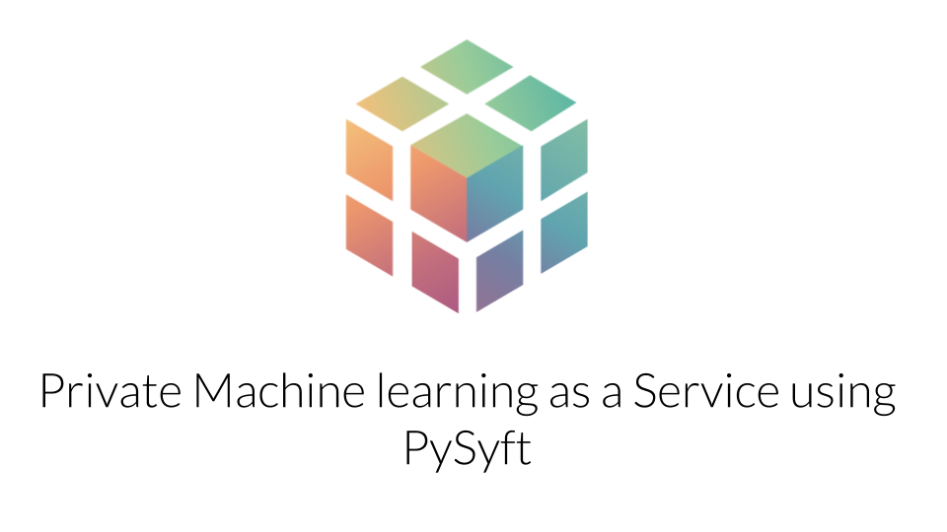
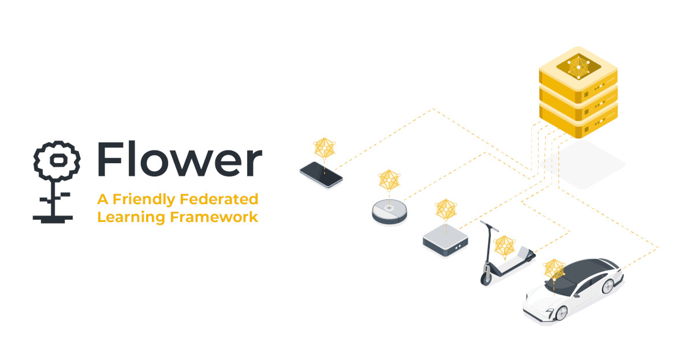

FL Frameworks Under Development
Several open-source libraries are under development: PySyft, TensorFlow Federated, FATE, Flower, Substra..

Slide 16
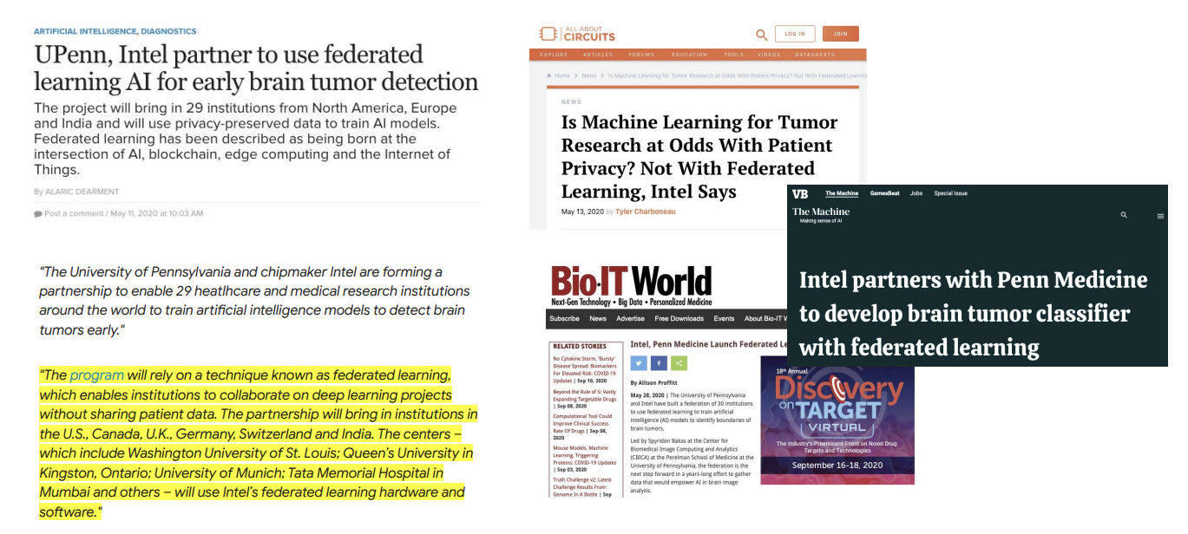
Applications - I

Slide 17
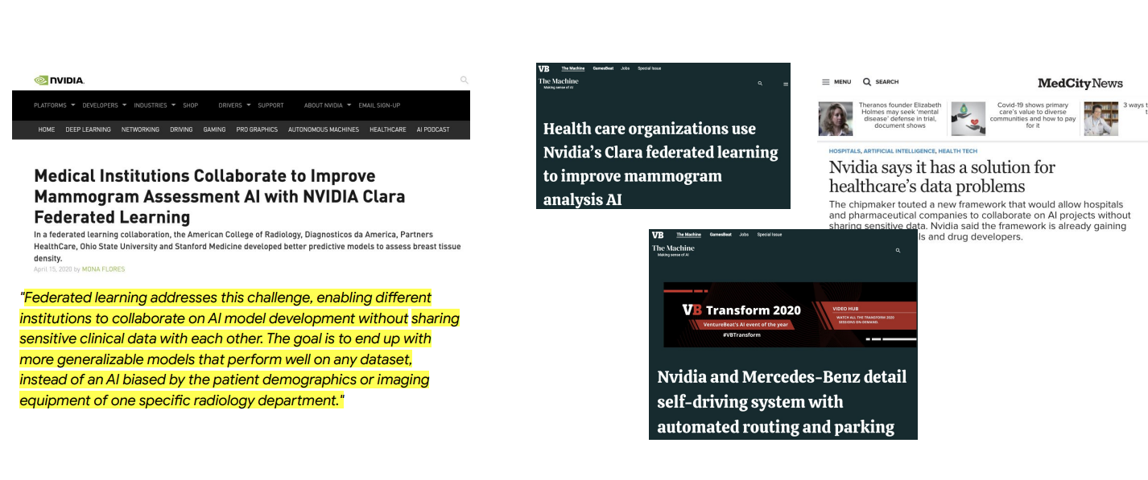
Applications - II

Slide 18
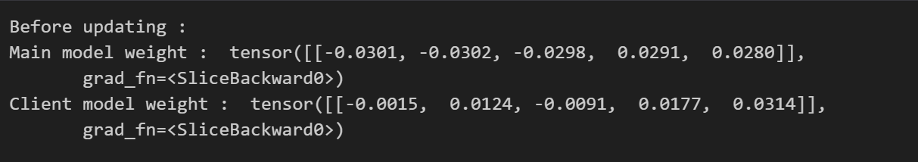
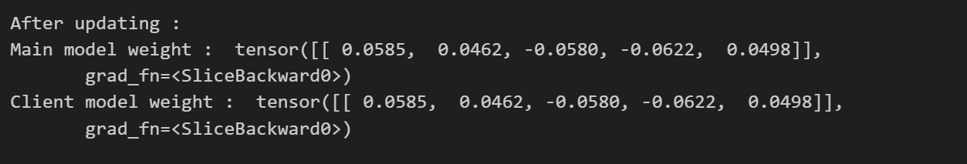
Weights Updating

Slide 19
SGD
Stochastic Gradient Descent (SGD) is an optimization algorithm used to train machine learning models.
It updates model parameters based on small random subsets of data, called batches, to minimize the difference between predicted and actual outputs (loss)
FL relies on SGD due to its ability to train models on decentralized data while preserving privacy.
SGD only requires sending small gradients, making it suitable for FL scenarios with limited bandwidth
SGD allows each device to update its local model using only its own data without requiring information from other devices or a central server.
weight = weight - lr * gradient - momentum * previous_update

Slide 20
Why not other optimization algos ?
Batch Gradient Descent: Requires the entire dataset to compute gradients, it would involve transmitting large amounts of data, compromising privacy and communication efficiency.
Mini-batch Gradient Descent: Requires sharing data between devices, leading to privacy concerns and communication challenges.
Genetic Algorithms: Involve a population-based approach with evolving solutions. This process might require sharing sensitive information and lacks the communication efficiency needed in FL.
Newton's Method: Requires calculating the Hessian matrix, which is computationally expensive and not practical for the distributed and resource-constrained nature of FL.

Slide 21
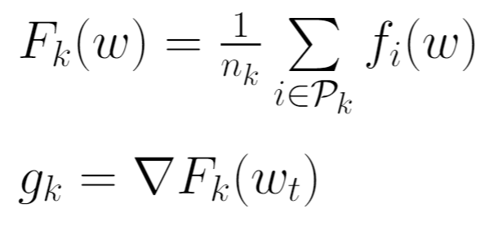
FedAvg

Slide 22
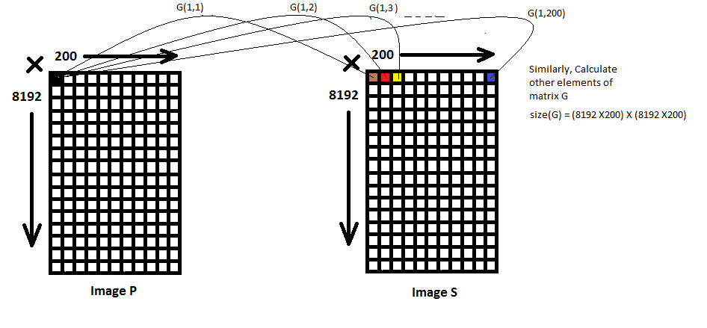
Euclidean distance in images

